Slide 1
An Investigation into How Best to Represent a 3D Cross Section of 4 Dimensional Objects
Joe Subbiani

Slide 2
Presentation Structure
What is the 4th Dimension
How to view the 4th Dimension
Building 4D Shapes
4D Rotation
Extensions to a 3D cross section
The Experiment
The Results

Slide 3
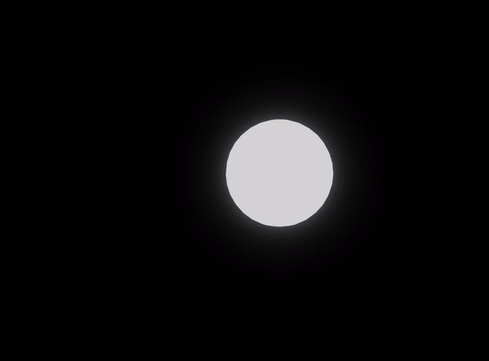
What is the 4th Dimension Structure

Slide 4
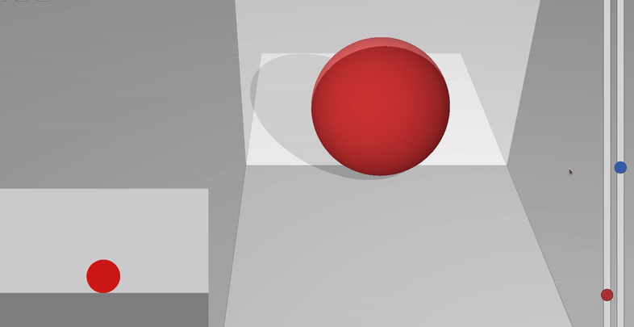
Taking A 3D Cross Section
How to view the 4th Dimension
We can take a 2D slice of a 3D object,.
Similarly, we can take a 3D slice of a 4D object.

Slide 5
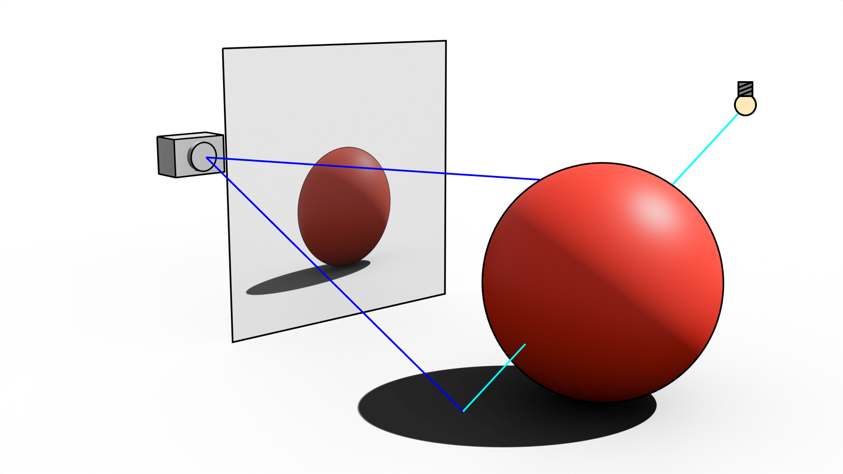
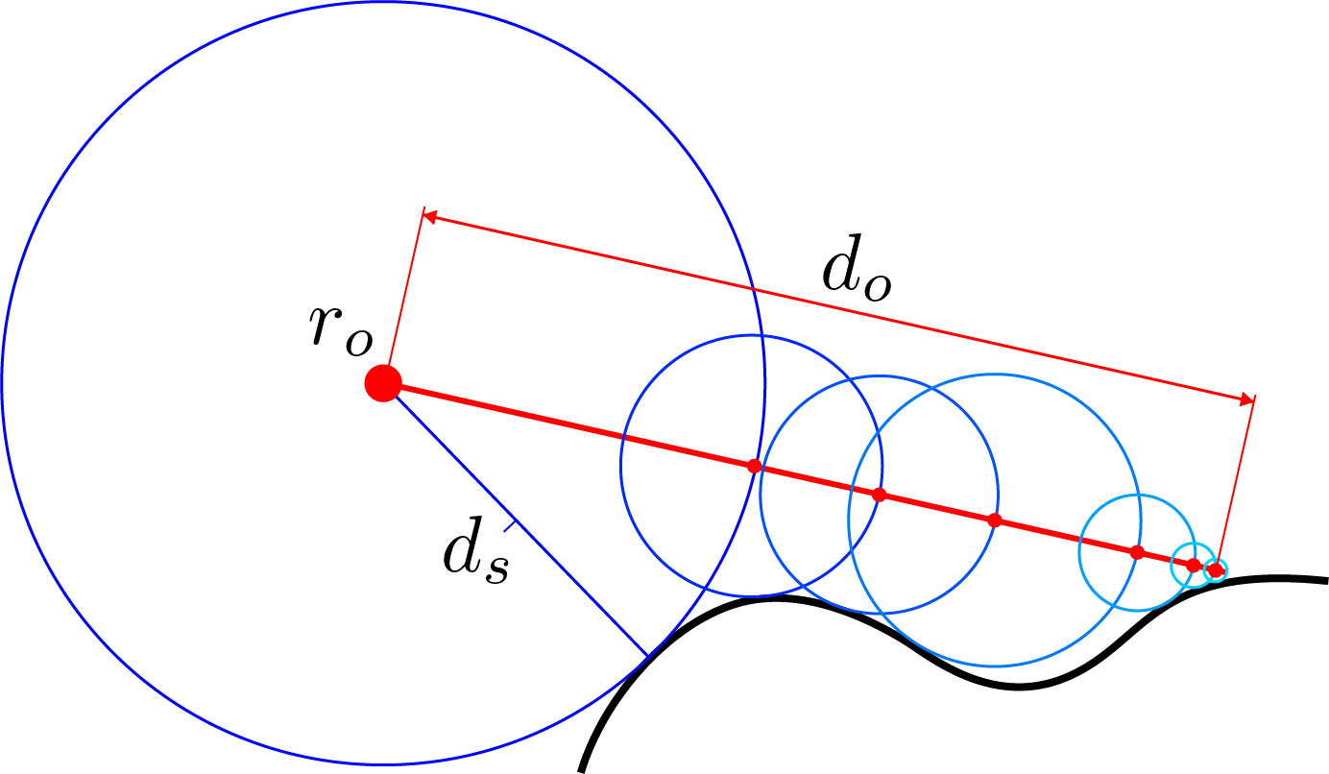
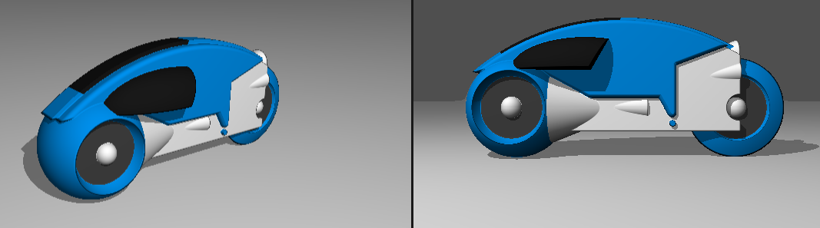
Ray Marching
Building 4D Shapes
Fun Fact: The original Tron used Ray Marching!

Slide 6
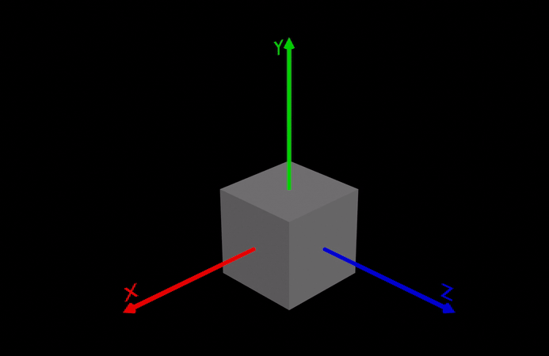
Rotating About a Plane
4D Rotation
Why leave the dimension to perform the rotation?
Planar rotation stays within the dimensions of rotation

Slide 7
The Rotor
4D Rotation

Slide 8
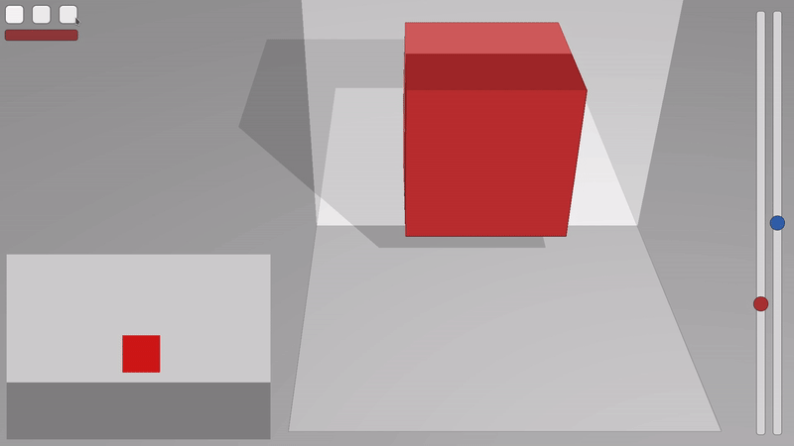
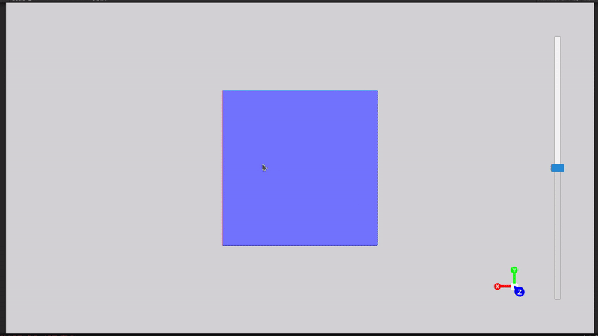

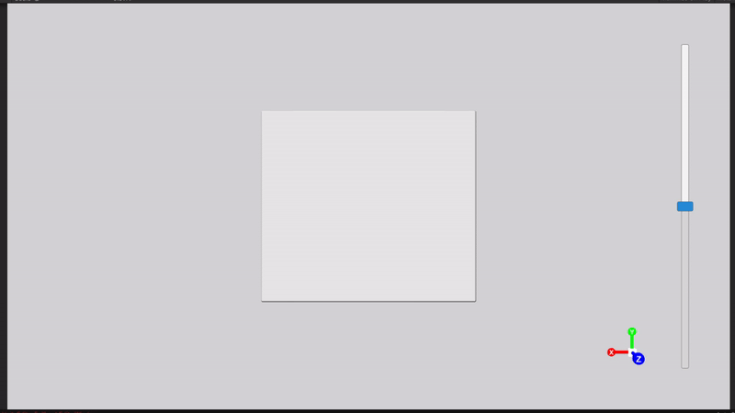
4D Rotation - 2D 3D 4D
2D Cross Section of 3D Object
3D Cross Section of 4D Object
Rotation within dimensions
Rotation outside of dimensions

Slide 9
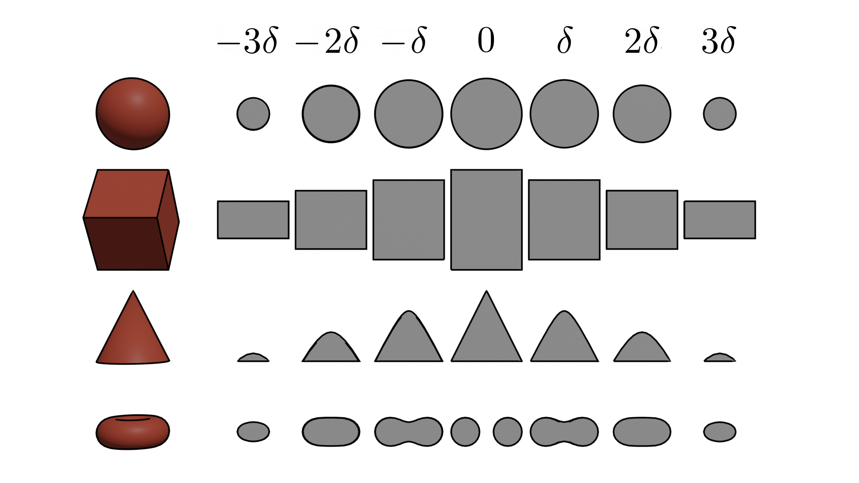
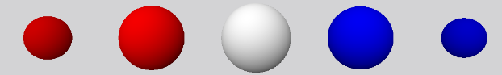
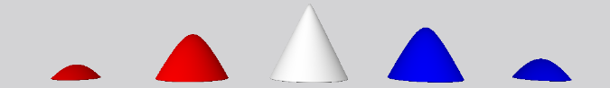
W-Axis “Timeline”
Extending a Cross Section of a 4D Object
2D cross section of 3D Object $δ=0.15$ 3D cross section of 4D object $δ=0.2$

Slide 10
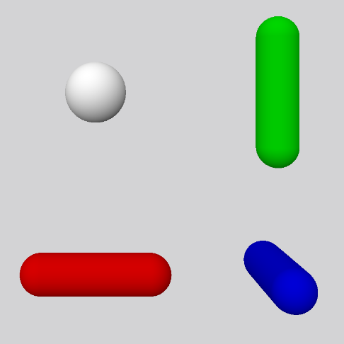
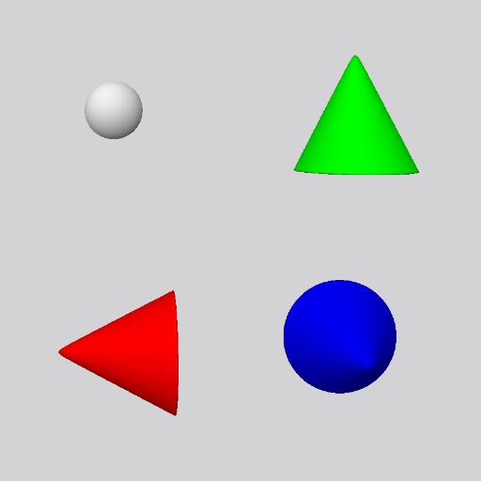
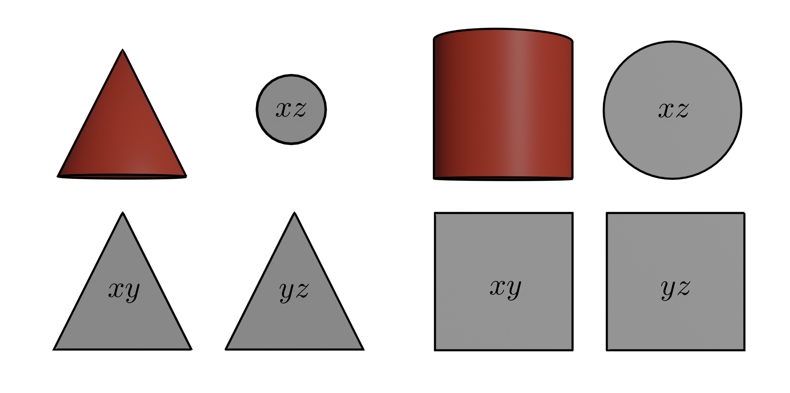
Multi-Rotational Views
Extending a Cross Section of a 4D Object

Slide 11
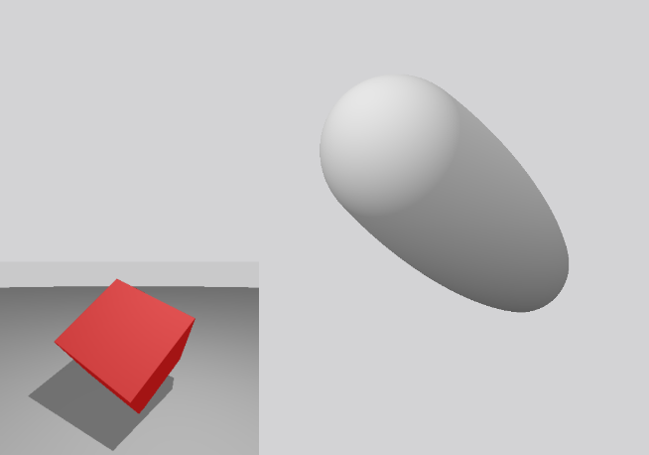
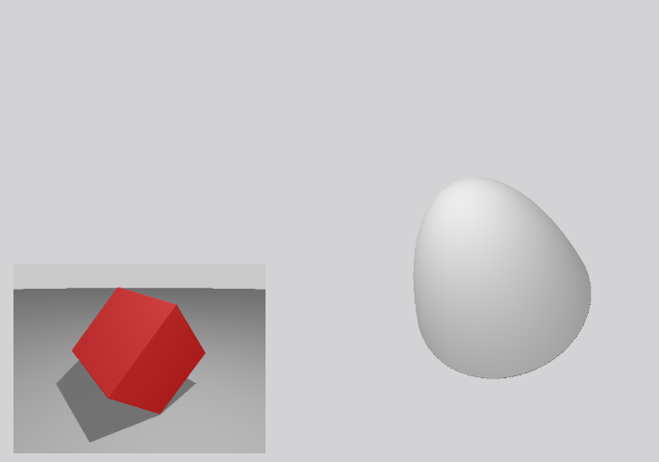
3D Axial Rotations on the 3D Component of a 4D Plane of Rotation
Extending a Cross Section of a 4D Object

Slide 12
Challenges
The Experiment
Challenging – time vs data
May have been too short for users

Slide 13
The van Hiele Model of Geometric Thinking
The Experiment
Stages in learning process
Needs people to understand

Slide 14
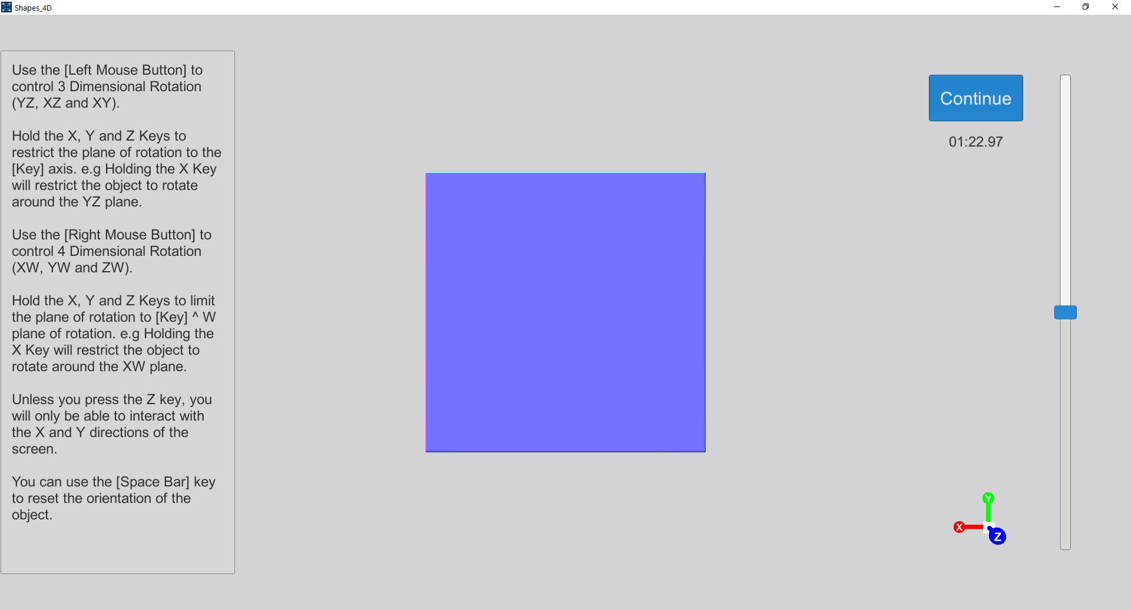
Introduction
The Experiment
Video
Small time to interact
Very much encourage questions

Slide 15
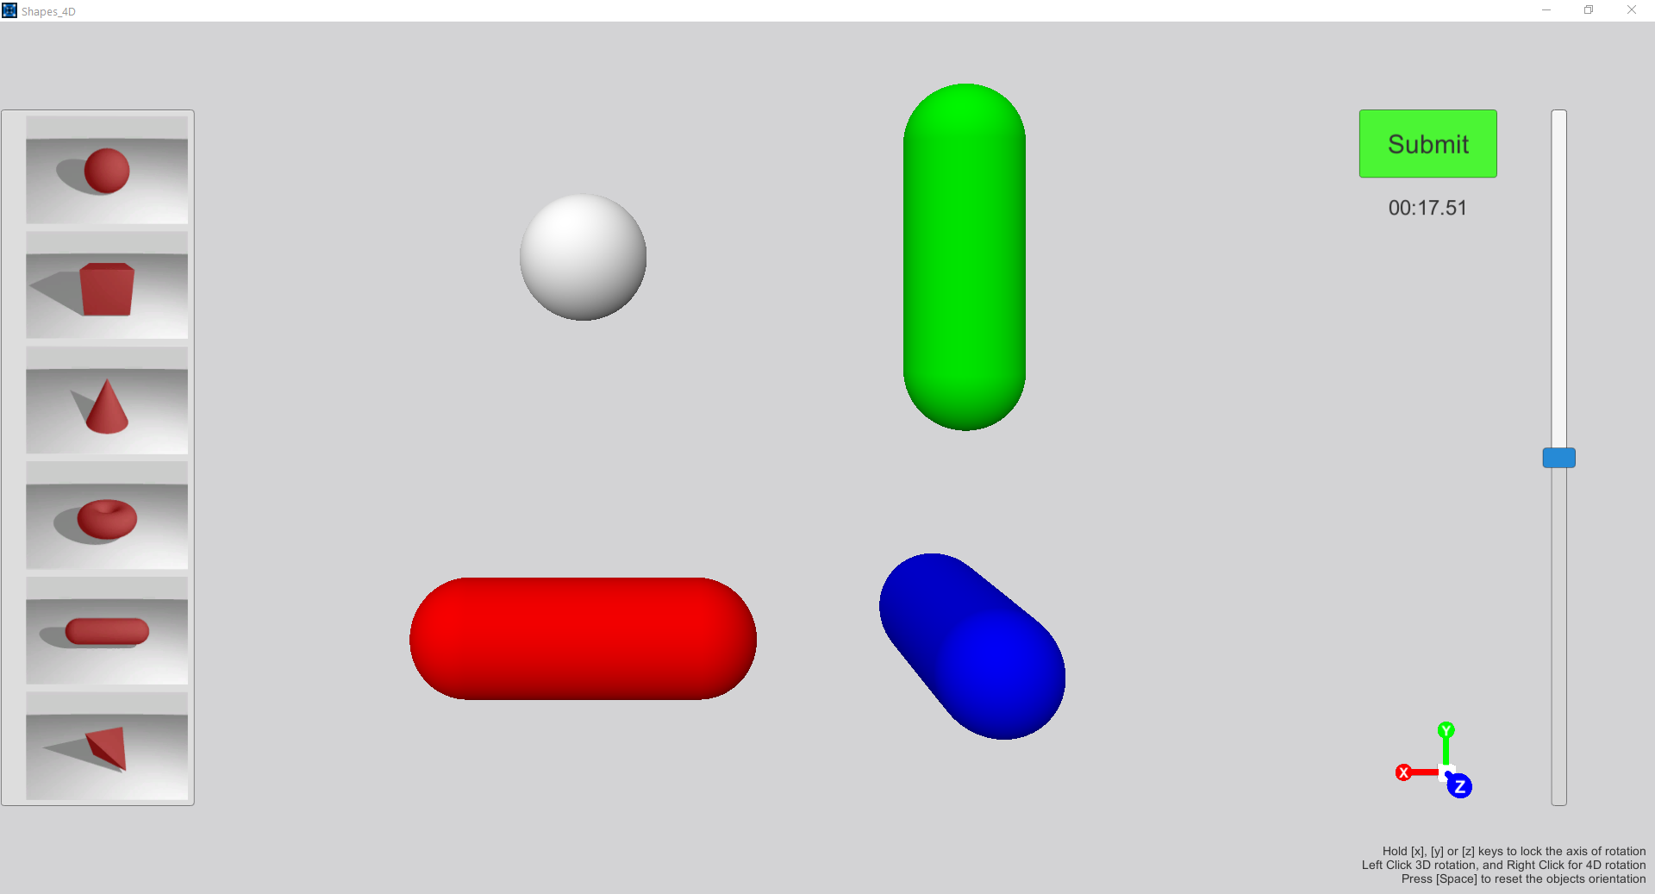
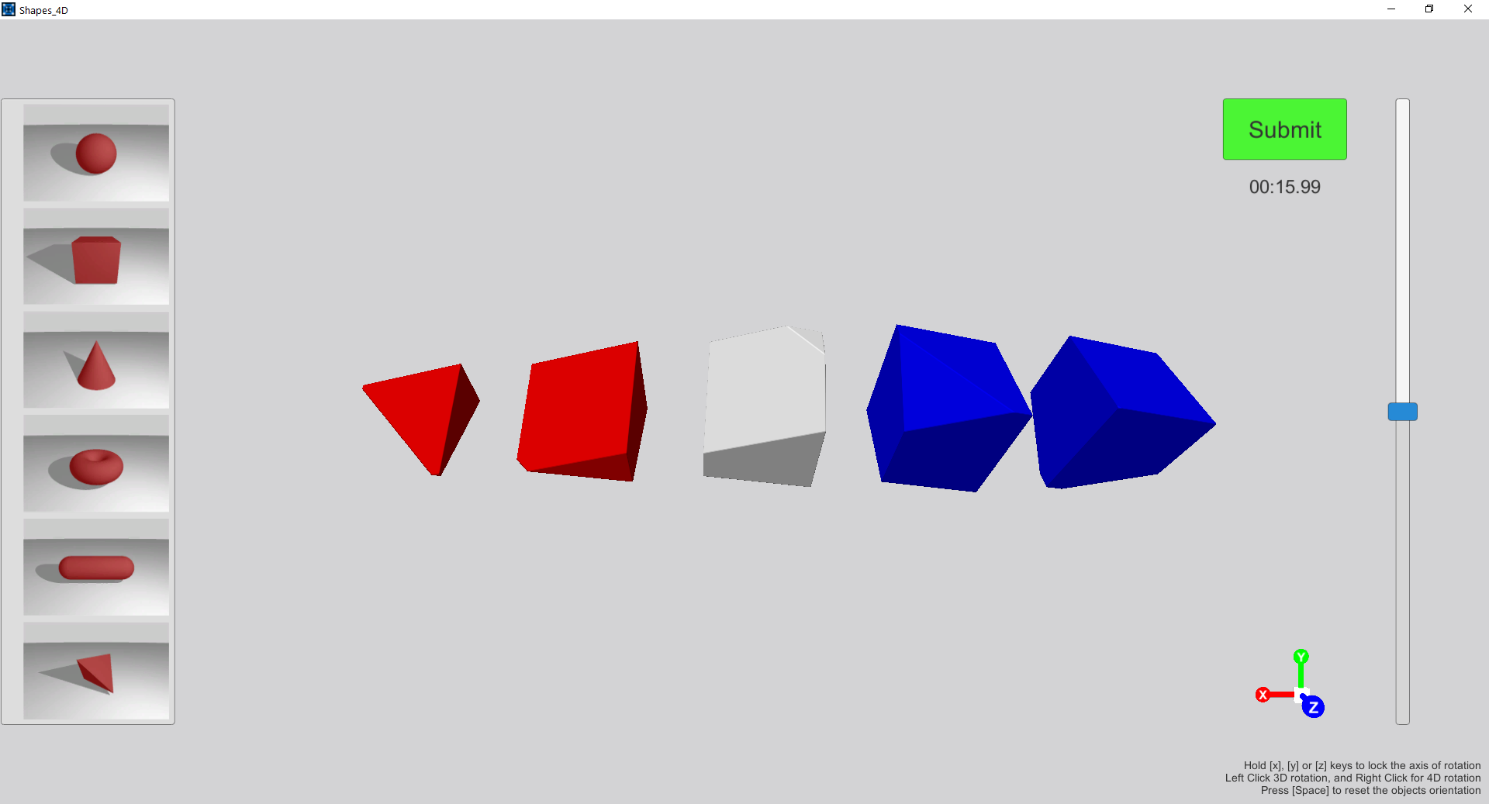
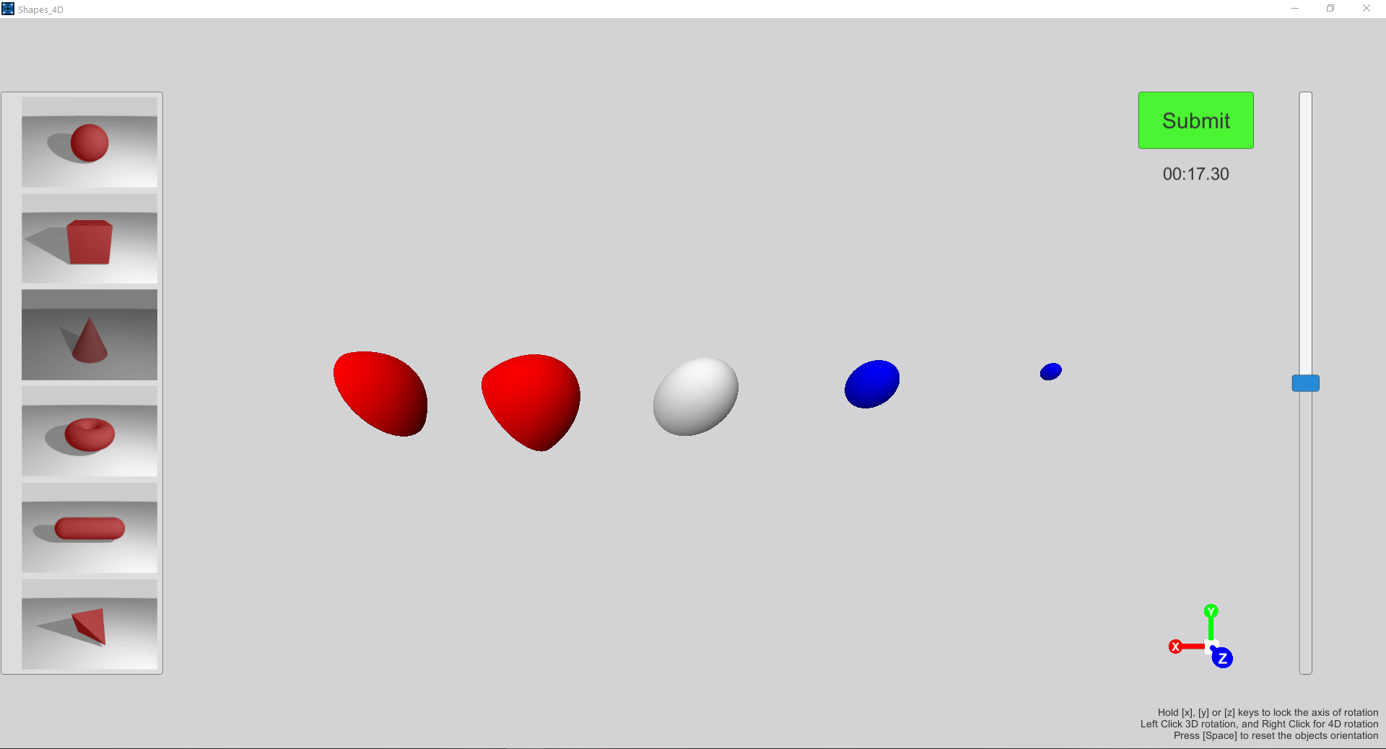
Shape Matching
The Experiment

Slide 16
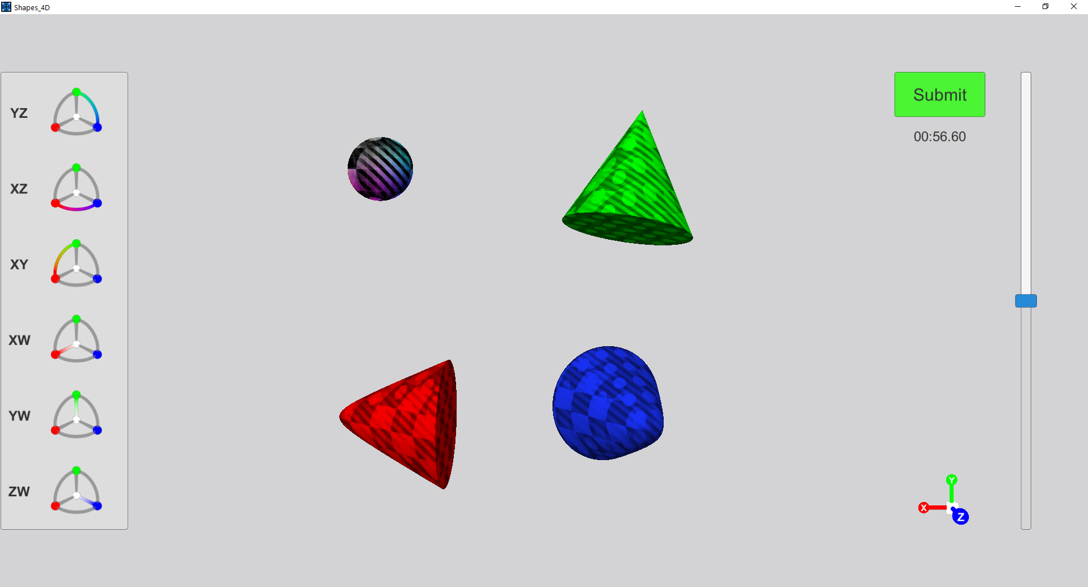
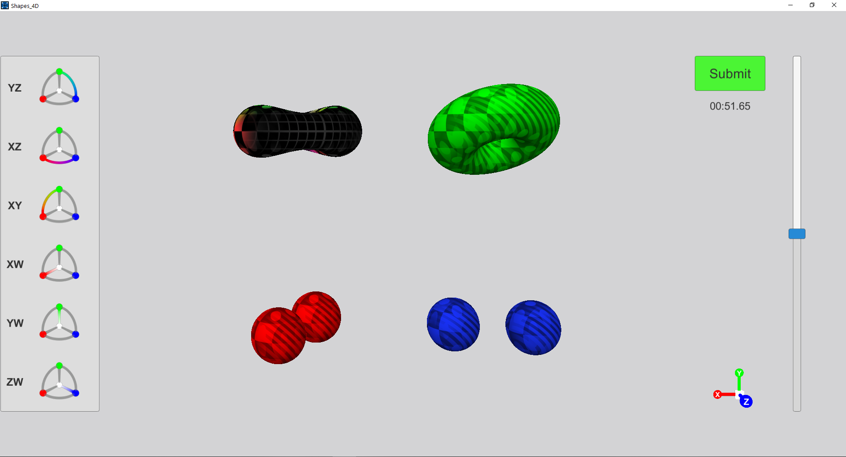
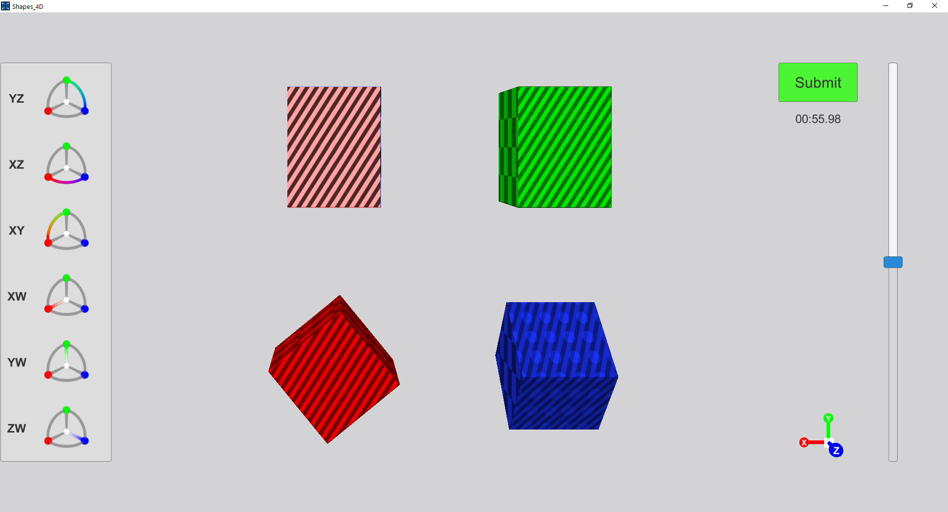
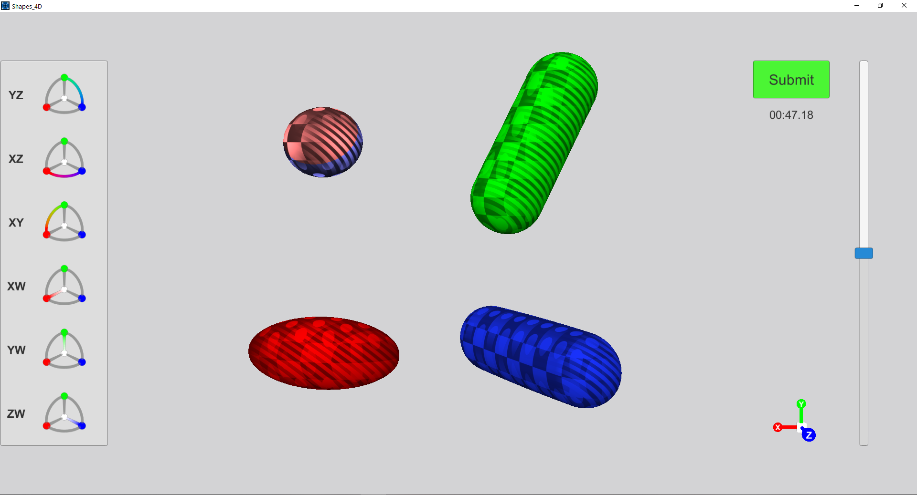
Rotation Matching
The Experiment

Slide 17
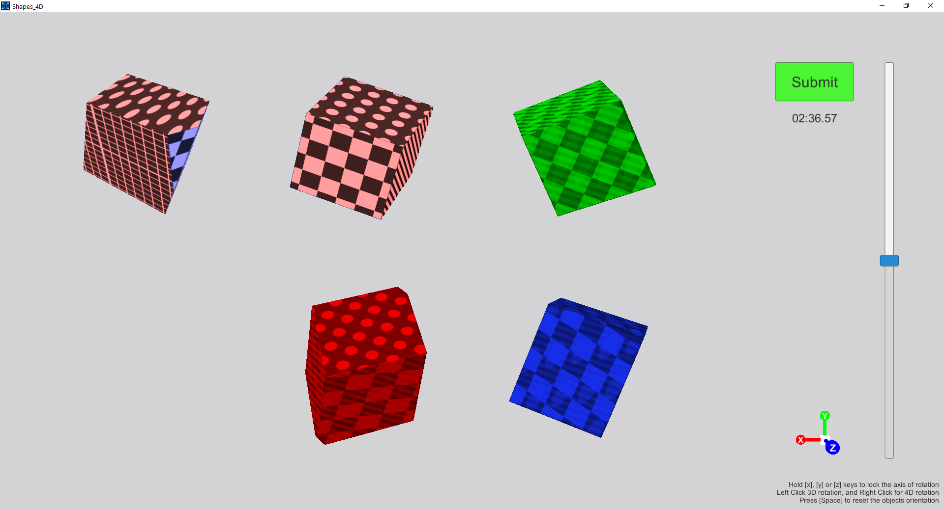
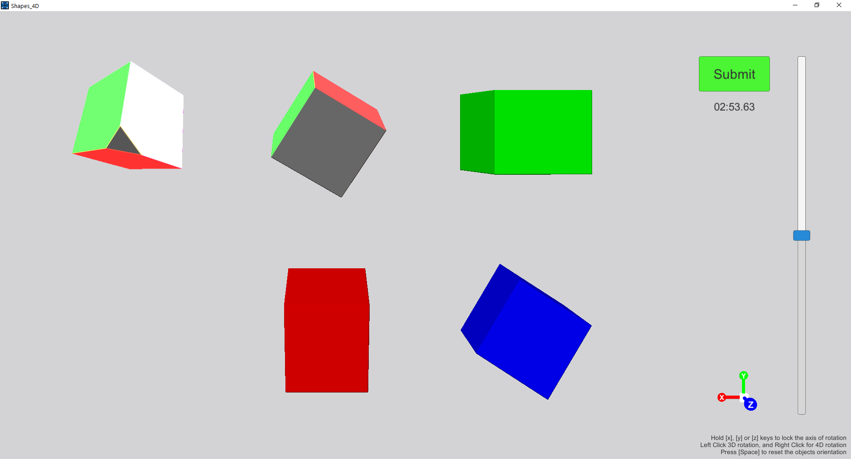
Pose Matching
The Experiment

Slide 18
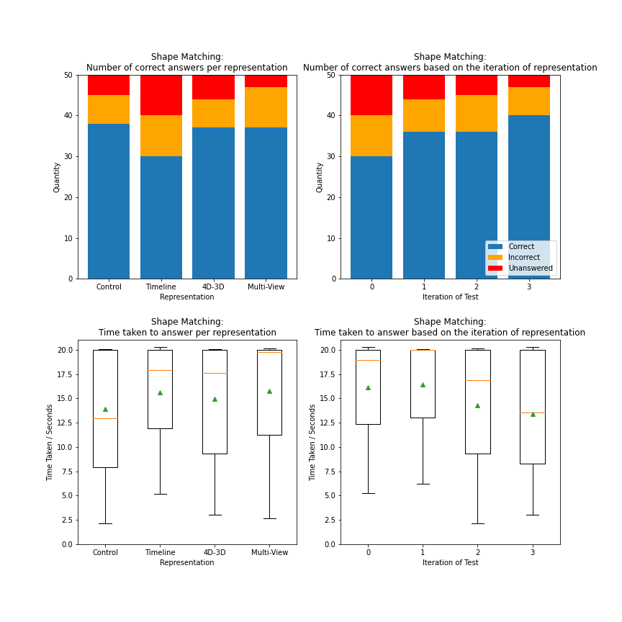

Shape Matching
The Results

Slide 19
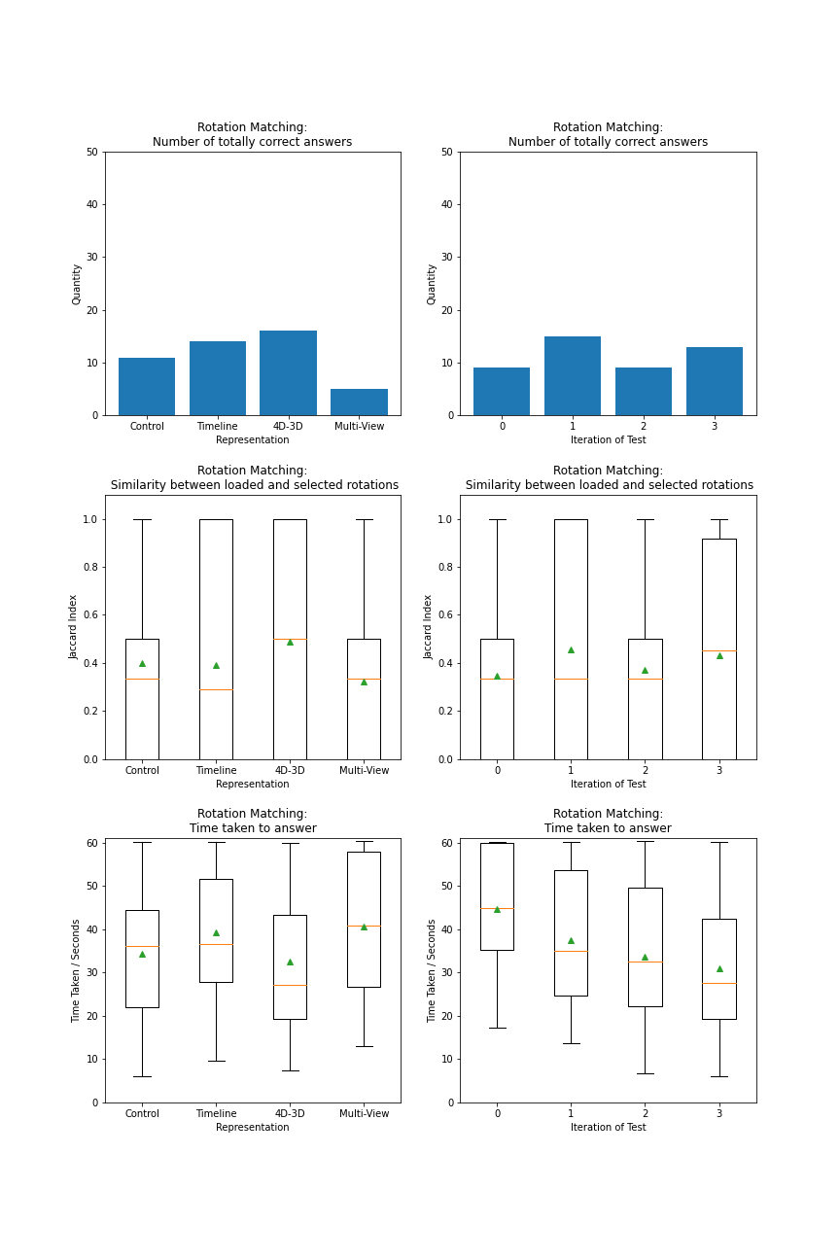

Rotation Matching
The Results

Slide 20
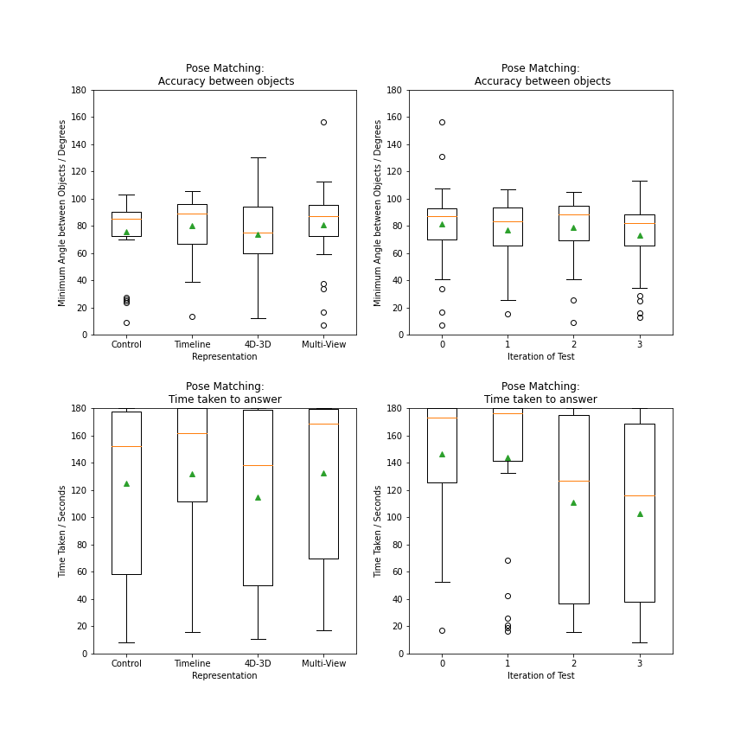

Pose Matching
The Results

Slide 21
Summary
The Results

